Slide 1
Woodlands CS Club
Minimax Algorithm
04/18/2021

Slide 2
Review:
This is our second meeting creating a tic-tac-toe bot! Last time, we created the game itself, and today, we’ll be creating the bot that plays against the player.
As always, you can find all the code used in this project on GitHub: https://github.com/WoodlandsComputerScience/Tic-Tac-Toe

Slide 3
What is minimax?
Minimax is a decision rule that makes decisions by minimizing the worst-case scenario while maximizing the minimum gain.
We’ll be looking at the minimax algorithm and how it pertains to game theory.
In the game of tic-tac-toe, each player can either win, lose, or draw. Using these states, we can then define some terms:
Maximum Gain: Winning in the least amount of moves
Specifically, if the player or bot can win in 1 move, then that is the optimal move.
Worst-case Scenario: Losing in the least amount of moves
Specifically, if the player can either draw or lose, then the optimal move to play for the draw.

Slide 4
LESS MOVES
LESS MOVES
-
+
LOSING
DRAW
WINNING
If the player is trying to maximize, then the minimax algorithm assumes that the bot is trying to minimize the player’s score (by maximizing its own score).
How Do We Write the Minimax Algorithm?
How do we evaluate the score at a position?
Since our opponent is trying to minimize our score, how do we “predict” our opponent’s move?
How do we know if we are winning or losing in less moves?

Slide 5
Minimax Algorithm
To use the minimax algorithm for tic-tac-toe, we will write the function recursively and then work backwards from the end of the game to determine the score at any given board position.
Before we get into the details though, let’s quickly review what recursion is!
Group A has covered this topic in a previous lesson, so we’ll quickly go over those slides now.

Slide 6
Minimax Algorithm (Cont.)
In our case, we’ll be using backtracking to generate all possible game states and take the ones that maximize the score for the player and minimize the score for the bot. Defining some terms:
Base Cases:
There are no more moves left to play on the board and neither player has won (draw)
Either the bot or the player has won the game (positive or negative)
Recurrence:
We’re generating all possible game states, so our recurrence is to play in any open squares.

Slide 7
def minimax(board, bot):
gameWon, player = check_win(board)
if(gameWon):
if(player == 1): return 1
else: return -1
if(not moves_left(board)):
return 0
if(bot): # bot's turn (minimizing)
bestScore = float('inf')
for i in range(3):
for j in range(3):
if(board[i][j] == 0):
board[i][j] = 2
bestScore = min(bestScore, minimax(board, False))
board[i][j] = 0
else: # player's turn (maximizing)
bestScore = float('-inf')
for i in range(3):
for j in range(3):
if(board[i][j] == 0):
board[i][j] = 1
bestScore = max(bestScore, minimax(board, True))
board[i][j] = 0

Slide 8
LESS MOVES
LESS MOVES
-
+
LOSING
DRAW
WINNING
We get a greater score if we win in less moves and a worse score if we lose in fewer moves, but how do we track how many moves are played before the end of the game?
Solution:
We can add a “depth” variable to our recursive function:
If we initialize this depth variable as the number of possible moves, and decrease it with every recurrence, when the game is a win, we can multiply the depth by 1 or -1 (depending on whether the bot or the player won).
Since the player is trying to maximize their score, a lower depth (more moves) will decrease the score.
Similarly, since the bot is trying to minimize their score, a greater depth (less moves) will increase the bot’s score.
Moreover, when the depth is 0, if there is no win on the board, then the game is a draw (removes the need for a moves_left function)

Slide 9
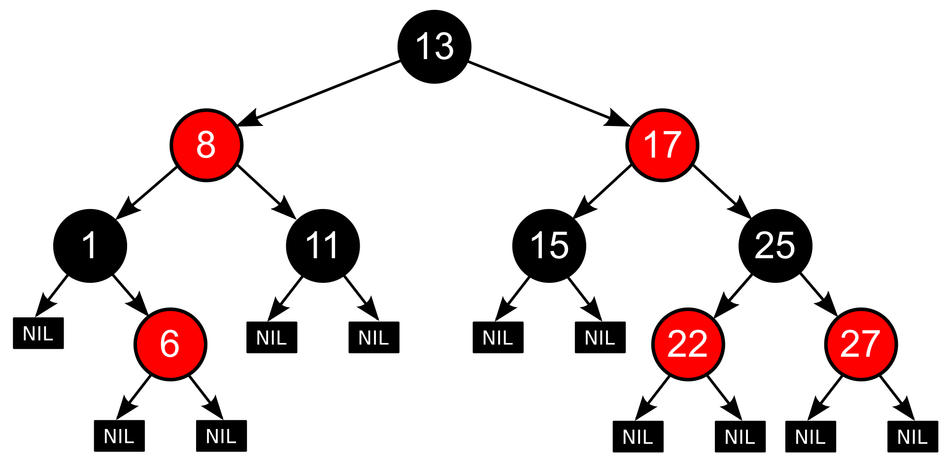
Minimax Algorithm Limitations
Although the minimax algorithm will play optimally, it brute-forces all the possible games.
In this diagram, it assumes that for each state, there are only two possible moves that can be played. For games like tic-tac-toe, the branching factor (# of possible moves at a certain position) is not very large. However, for more complex games such as chess, this branching factor is much greater (time complexity of O(b^{m}) where b is the branching factor and m is the maximum depth), meaning that this algorithm becomes tremendously slow.

Slide 10
Minimax Algorithm Optimizations
Alpha-beta pruning
Move ordering
Transposition table / dynamic programming
Bit manipulation
Limiting calculations

Slide 11
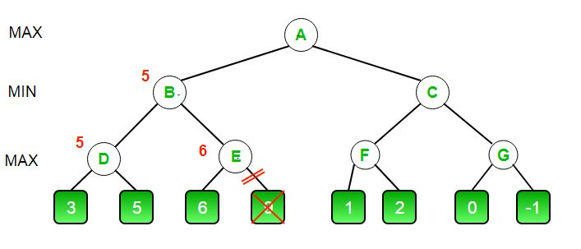
Alpha-Beta Pruning
Optimization to prune away branches in our search tree. Some moves will not affect the final outcome because a more optimal move has already been made/calculated.
≤5
Worst-case : O(b^{m})
Best-case : O(b^{m/2})
≥6

Slide 12
Alpha-Beta Pruning (Cont.)
Keep track of variables alpha and beta in minimax.
alpha = score that the maximizing player is assured
beta = score that the minimizing player is assured
Whenever the best score for the minimizing player is less than or equal to the best score for the maximizing player, we can prune the other branches from this node.
if (beta <= alpha):
prune other descendants

Slide 13
Move Ordering
We can actually use another optimization to improve the number of branches that our alpha-beta algorithm prunes.
We sort the moves so that those with a higher chance of being good are considered first. This is a huge optimization for games like chess, and they are often based on certain rules of thumb - it is more likely that a capture move in chess would be a better move than a non-capture move.
As an example for tic-tac-toe:
Rank | Move
1 | Win the game (move around previous placed pieces)
2 | Prevent a loss (search the squares around the opponent’s newly placed piece)

Slide 14
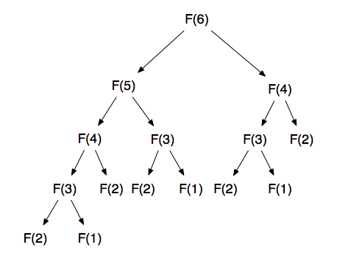
Transposition Table
Since each function call is very expensive (requires us to brute force a significant number of games), caching the information for a certain position can allow us to instantly find the best move if we ever reach this position again.
This optimization relies on the fact that there are multiple ways to reach the same position, and once at this same position, the optimal move remains the same.

Slide 15
Limiting Calculations
With bigger board sizes, even with the previous optimizations, it is still requires too many operations to simulate all the possible games.
Instead, we only allow our minimax algorithm to search up to a certain depth. Consequently, our bot will not play perfectly, but the exponential searching time is main limitation of the minimax algorithm in the first place.
Since we are unable to simulate games to their finish, we also have to create an evaluation function to determine the favorability of a position.
For tic-tac-toe, our evaluation function can be based on:
Number of straight lines (number of 3 in a rows, number of 4 in a rows, etc.)
Number of opponent’s straight lines (number of 3 in a rows, number of 4 in a rows, etc.)

